Slide 1
Pneumonia Detection Using CNN
Challa Gopala Krishna (21ECB0B09)
Kaveti Shrikar
(21ECB0B21)

Slide 2
What is Pneumonia?
Pneumonia is a Inflammatory condition of lung primarily affecting the small air sacs known as alveoli
Symptoms typically include some combination of productive or dry cough, chest pain, fever, and difficulty breathing. The severity of the condition is variable.
Pneumonia is usually caused by infection with viruses or bacteria, and less commonly by other microorganisms.
Identifying the responsible pathogen can be difficult. Diagnosis is often based on symptoms and physical examination. Chest X-rays, blood tests, and culture of the sputum may help confirm the diagnosis.
Each year, pneumonia affects about 450 million people globally (7% of the population) and results in about 4 million deaths.

Slide 3
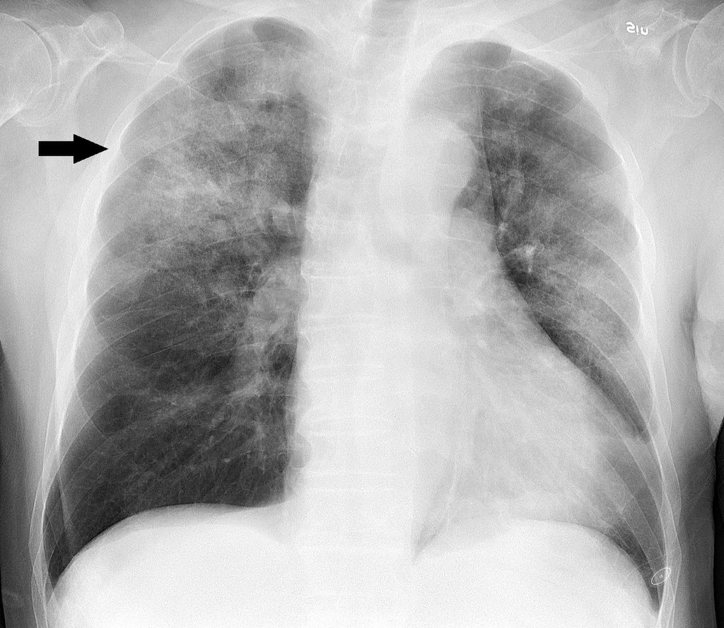
Detection of pneumonia using chest x-ray
The Image on the Right Side Shows Chest radiograph of an 88 year old man, about one week after onset of fever, fatigue and mild coughing. Lab tests detected both Influenza A virus and Haemophiles influenzae. It shows multifocal, patchy consolidation, mainly in the right upper lobe.
X-Rays can are used to understand severity of the disease but analysis of Chest X-rays is complex and can only be done by experienced Radiologists

Slide 4
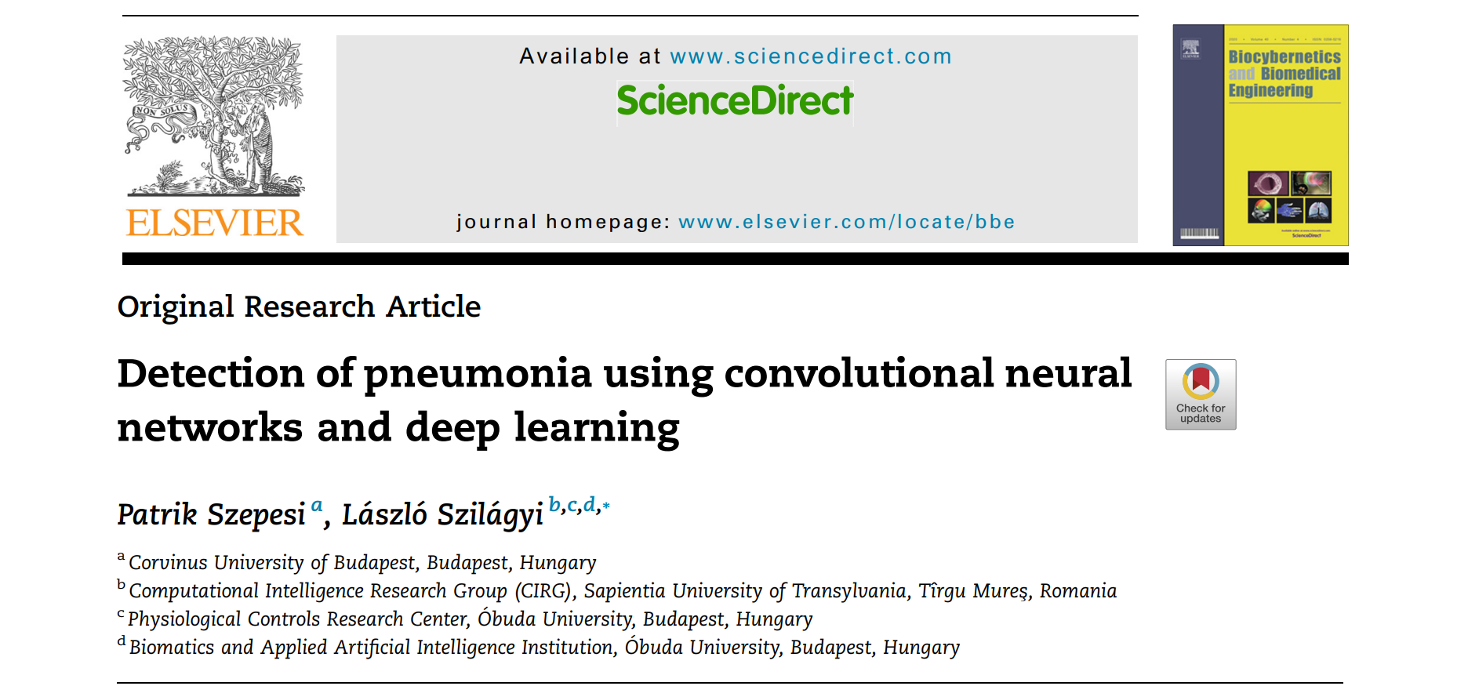
Reference (https://www.sciencedirect.com/science/article/pii/S0208521622000742#:~:text=They%20obtained%20an%20accuracy%20of,obtained%20a%2092.3%25%20averaged%20score.)

Slide 5
About the dataset being used
Content (https://data.mendeley.com/datasets/rscbjbr9sj/2)
The dataset is organized into 3 folders (train, test, Val) and contains subfolders for each image category (Pneumonia/Normal). There are 5,863 X-Ray images (JPEG) and 2 categories (Pneumonia/Normal).
Chest X-ray images (anterior-posterior) were selected from retrospective cohorts of pediatric patients of one to five years old from Guangzhou Women and Children’s Medical Center, Guangzhou. All chest X-ray imaging was performed as part of patients’ routine clinical care.
For the analysis of chest x-ray images, all chest radiographs were initially screened for quality control by removing all low quality or unreadable scans. The diagnoses for the images were then graded by two expert physicians before being cleared for training the AI system. In order to account for any grading errors, the evaluation set was also checked by a third expert.

Slide 6
Algorithm
Librares used
matplotlib.pyplot
seaborn
TensorFlow
Keras
model (Sequential)
layers (Dense, Conv2D, MaxPool2D, Flatten, Dropout, BatchNormalization)
pre - processing (ImageDataGenerator)
callbacks (ReduceLROnPlateau)
Sklearn
Sklearn - metrics (classification report, confusion matrix)
open-cv2 python
os python

Slide 7
Pre – processing
Reading ‘Input’ Directories and Reading all Image Files using open-cv and converting RGB to Grayscale Image
Converting Image to Grayscale because Detecting of features in X-ray is best in Grayscale and as all X-rays are in Grayscale
Re – Shaping Image Data Array and Dividing Data into Training and Testing Data
Splitting Input data into Test and Train data
Using ImageDataGenerator to randomly shift Image Pixels and Rotate Image
Rotating makes sure that we get the exact result even if input image is tilted.
Zoom range trains the model with different zoom levels.
Horizontal flip- Makes sure x-ray is analysed irrespective of which side we keep.
The training data is then fed to this ImageDataGenerator function for data augmentation.

Slide 8
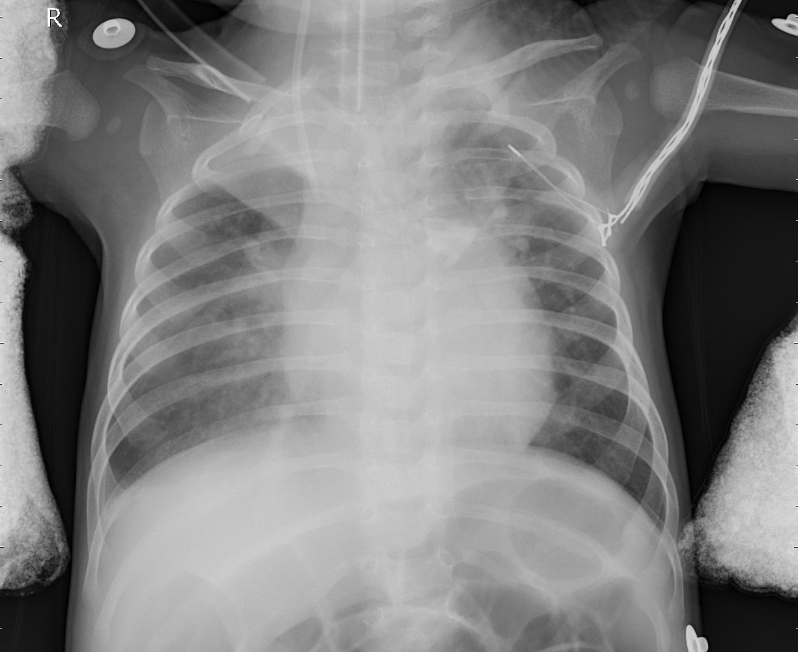
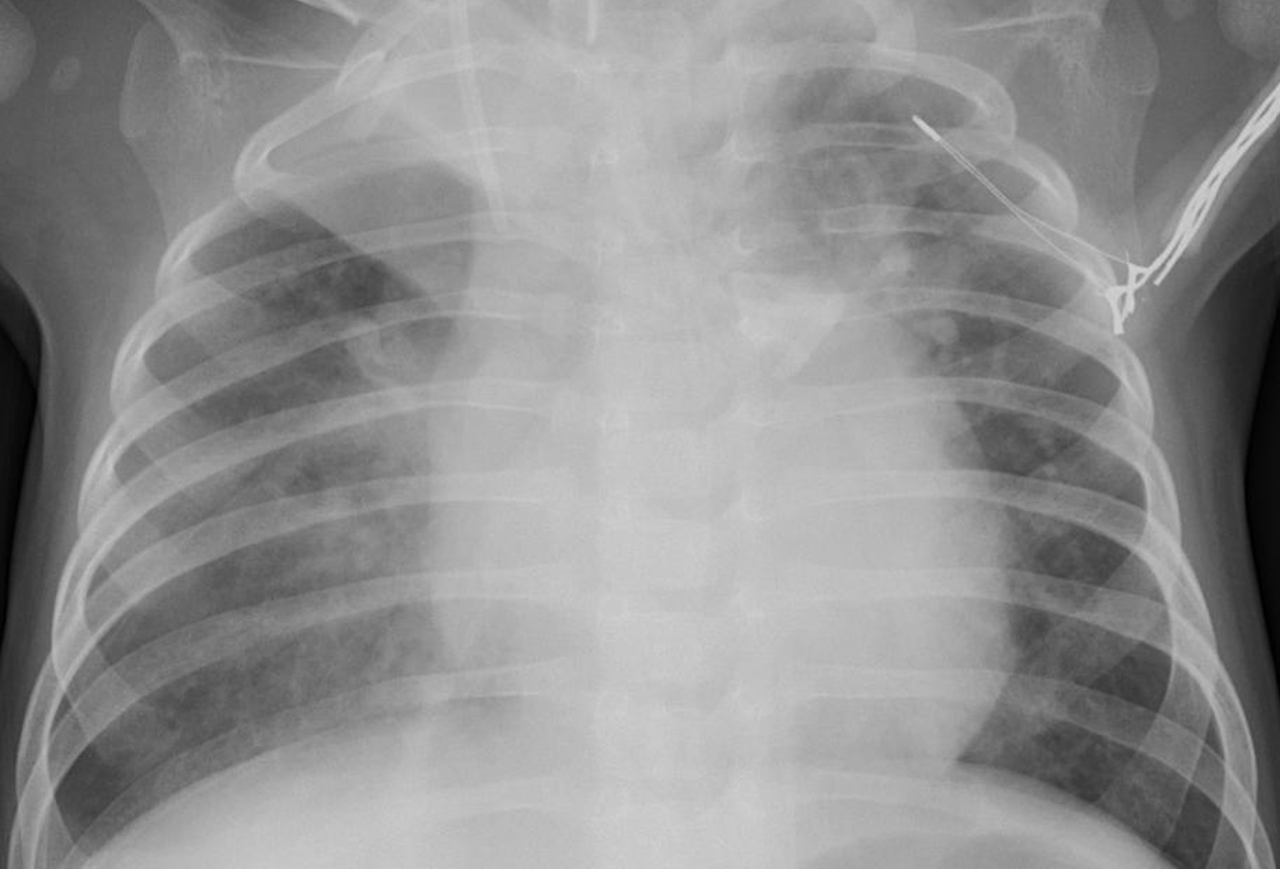
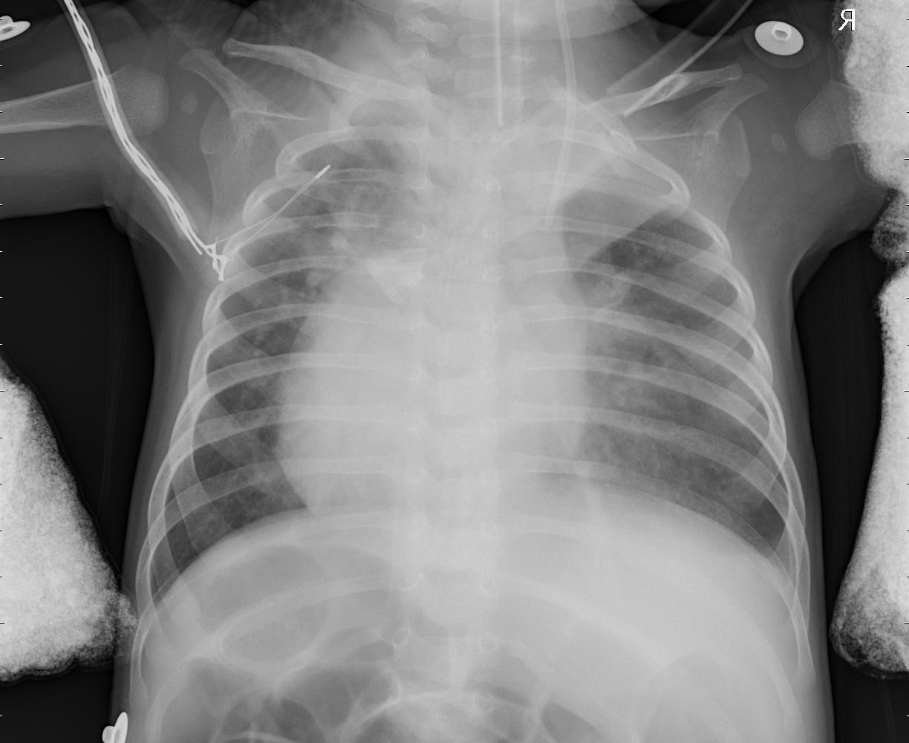
Rotation of Image
Image Zoom
Horizontally Flipping Image

Slide 9
Layers in cnn
Total number of layers-22
The different layers that have been used are
1. Convolution layer (No of Filters = 32, 64, 128, 256, Filter Size(Kernel size) = 3x3, Activation function - ReLU)
2. Batch Normalisation
3. Maxpooling layers
4. Dropout
5. Flatten
6. Dense

Slide 10
Layers in cnn
No of Images used to Train Model – 5,262
After Pre-processing and Data Augmentation, Final length of data - 5,262
Batch size - 32 (No of samples processed before updating the model)
No of epochs - 12
No of samples trained in one epoch – 5,262

Slide 11
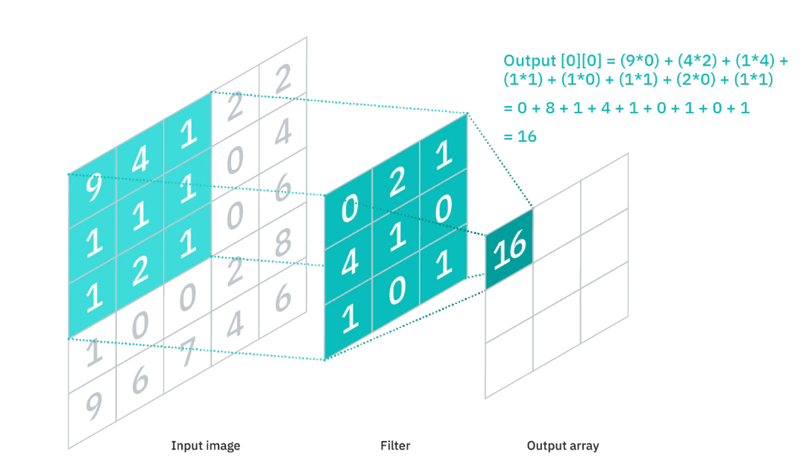
Convolution layer
Convolution is an orderly procedure where two sources of information are intertwined; it’s an operation that changes a function into something else. The first layer of a Convolutional Neural Network is always a Convolutional Layer.
Convolutional layers apply a convolution operation to the input, passing the result to the next layer. A convolution converts all the pixels in its receptive field into a single value. The final output of the convolutional layer is a vector.

Slide 12
Convolution layer
Convolution Layer parameters:
1. Filters: Represent no of features to be extracted
2. Kernel Size: The kernel size refers to the width x height of the filter mask
3. Strides: No of columns through which filter is moved
4. Padding: No. of Border pixels added to Image to Extract Edge pixel Characteristics
5. Activation function: ReLU

Slide 13
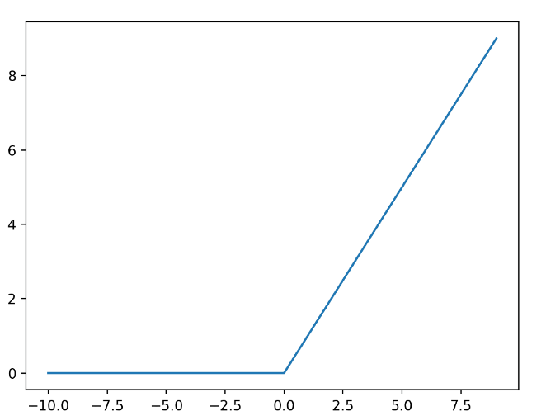
Relu activation function
The Rectified linear activation function or ReLU for short is a piecewise linear function that will output the input directly if it is positive, otherwise, it will output zero. It is the default activation function for many types of neural networks because a model that uses it is easier to train and often achieves better performance.

Slide 14
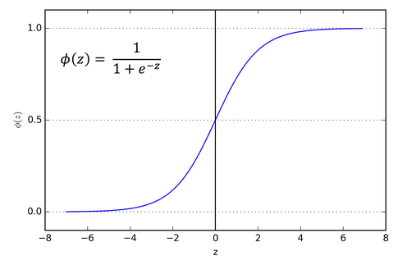
Sigmoid activation function
A sigmoid function is a mathematical function having a characteristic "S"-shaped curve or sigmoid curve.
A common example of a sigmoid function is the logistic function shown in the first figure and defined by the formula on Right Side
A sigmoid function is a bounded, differentiable, real function that is defined for all real input values and has a non-negative derivative at each point[1] and exactly one inflection point. A sigmoid "function" and a sigmoid "curve" refer to the same object.

Slide 15
Batch normalisation
Deep neural networks with tens of layers can be sensitive to initial random weights and configuration of learning algorithm. The distribution of inputs to layers deep in network may change after each mini-batch when the weights are updated. This can cause the learning algorithm to forever chase a moving target. This can be prevented using batch normalization.
Batch normalization is a technique for training very deep neural networks that standardizes the inputs to a layer for each mini-batch. This has the effect of stabilizing the learning process and dramatically reducing the number of training epochs required to train deep networks.
This method helps us to avoid overfitting and makes the learning process more efficient. A typical neural network is trained using a collected set of input data called batch. Similarly, the normalizing process in batch normalization takes place in batches, not as a single input.

Slide 16
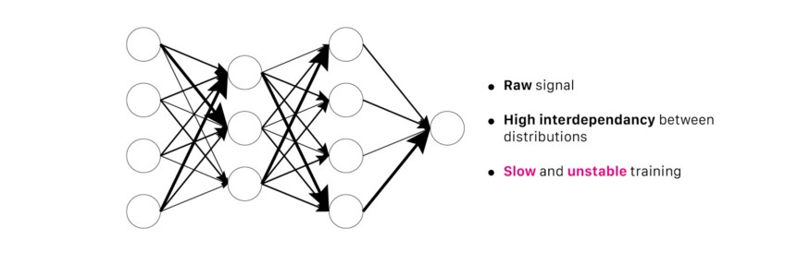
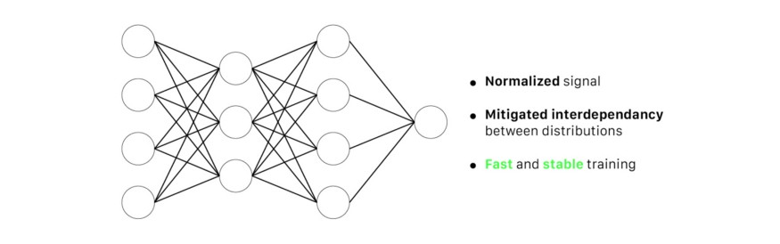
Batch Normalization
1. Batch Normalization Re-centres and Re-scales the Input layers.
2. Batch normalization transforms the Input Data and Re-Distributes the data to decrease Unstability
3. It changes the learning rate to optimum value to decrease losses during initialization.
4. Introduces Non-Linearity

Slide 17
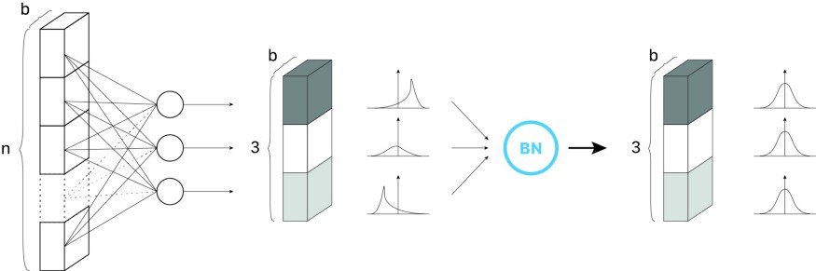


Batch Normalization

Slide 18
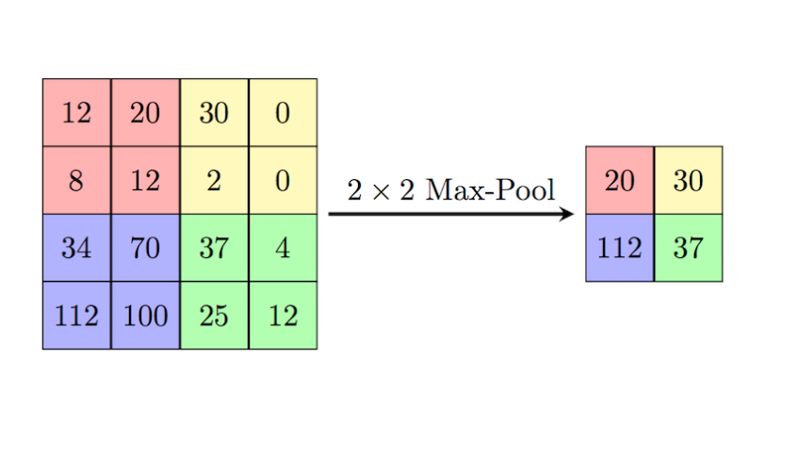
Max pooling
Max Pooling is a pooling operation that calculates the maximum value for patches of a feature map, and uses it to create a down sampled (pooled) feature map. It is usually used after a convolutional layer.
Pooling layers are used to reduce the dimensions of the feature maps. Thus, it reduces the number of parameters to learn and the amount of computation performed in the network. It also makes the model more robust to variations in the position of the features in the input image.

Slide 19
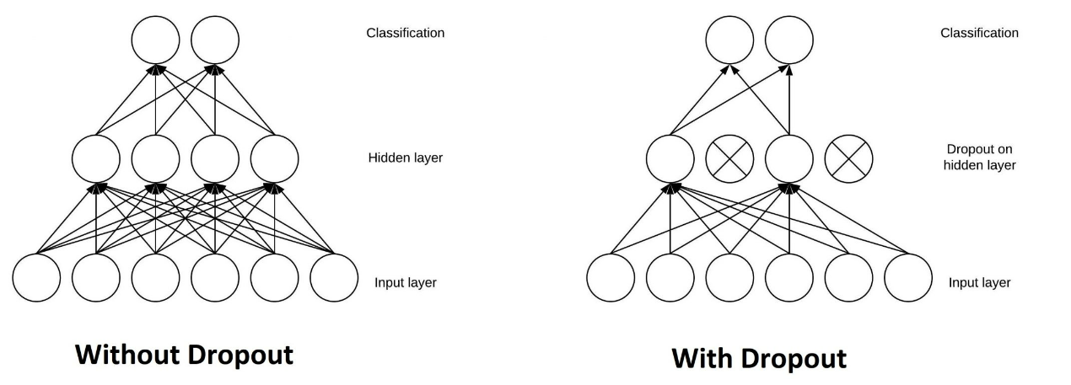
dropout
Dropout in machine learning refers to the process in which certain nodes are randomly ignored during training. This is done in order to reduce overfitting and improve generalisation error in deep neural networks.
We used 0.1 and 0.2 rate of Frequency to set sample to Zero
1 / (1 – Rate) Samples are not set to zero and pass to next layer
Sum of the Input will be the same and Re-Distributed

Slide 20
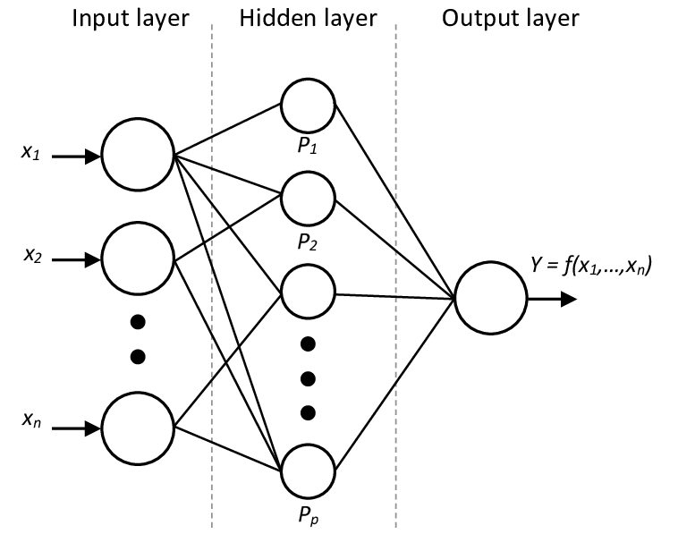
Dense (Hidden layers)
The dense layer is a neural network layer that is connected deeply, which means each neuron in the dense layer receives input from all neurons of its previous layer.
In the background, the dense layer performs a matrix-vector multiplication. The values used in the matrix are actually parameters that can be trained and updated with the help of backpropagation.

Slide 21
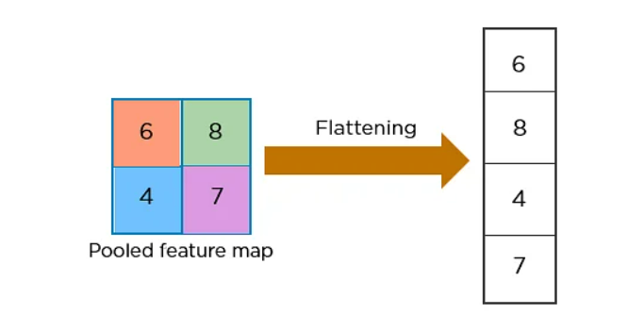
Flatten Layer
Flattening is used to convert all the resultant 2-Dimensional arrays from pooled feature maps into a single long continuous linear vector.
The flattened matrix is fed as input to the fully connected layer to classify the image.

Slide 22
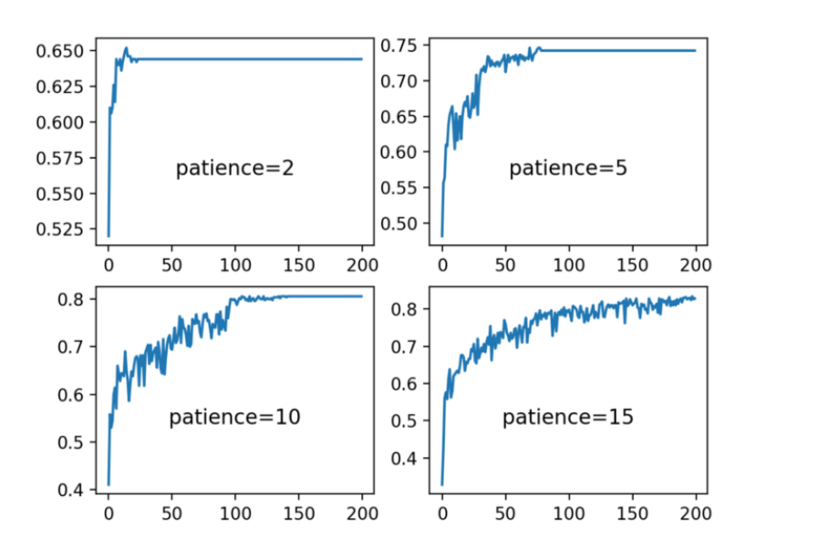
Reduce LR On Plateau
Reducelronplateau means to Reduce learning rate when a metric has stopped improving.
Models often benefit from reducing the learning rate by a factor of 2-10 once learning stagnates. This callback monitors a quantity and if no improvement is seen for a 'patience' number of epochs, the learning rate is reduced.

Slide 23
Compiling the model
After defining all the layers, we compile the model so that it can be used for training and testing. In order to compile, we use optimizers and loss functions.
Optimizers are algorithms or processes used to minimize error and maximize efficiency. This is done by changing the model’s trainable parameters i.e., weights and biases.
A loss function is a function that compares the target and predicted output values; measures how well the neural network models the training data. When training, we aim to minimize this loss between the predicted and target outputs.

Slide 24


optimizer
A derivative of loss function for given parameters at a given time t.
Update parameters for given input i and at time/iteration t
Optimizers are algorithms or methods used to change the attributes of your neural network such as weights and learning rate in order to reduce the losses.
Adagrad is a extension of gradient decent with a changing learning rate for each individual parameter (Weights).
Adagrad finds learning of each parameter by first summing all partial derivatives seen so far in NN and then divides the initial learning rate by square root of sum of square of partial derivative.
Rmsprop is a extension of Adagrad with decaying Average

Slide 25
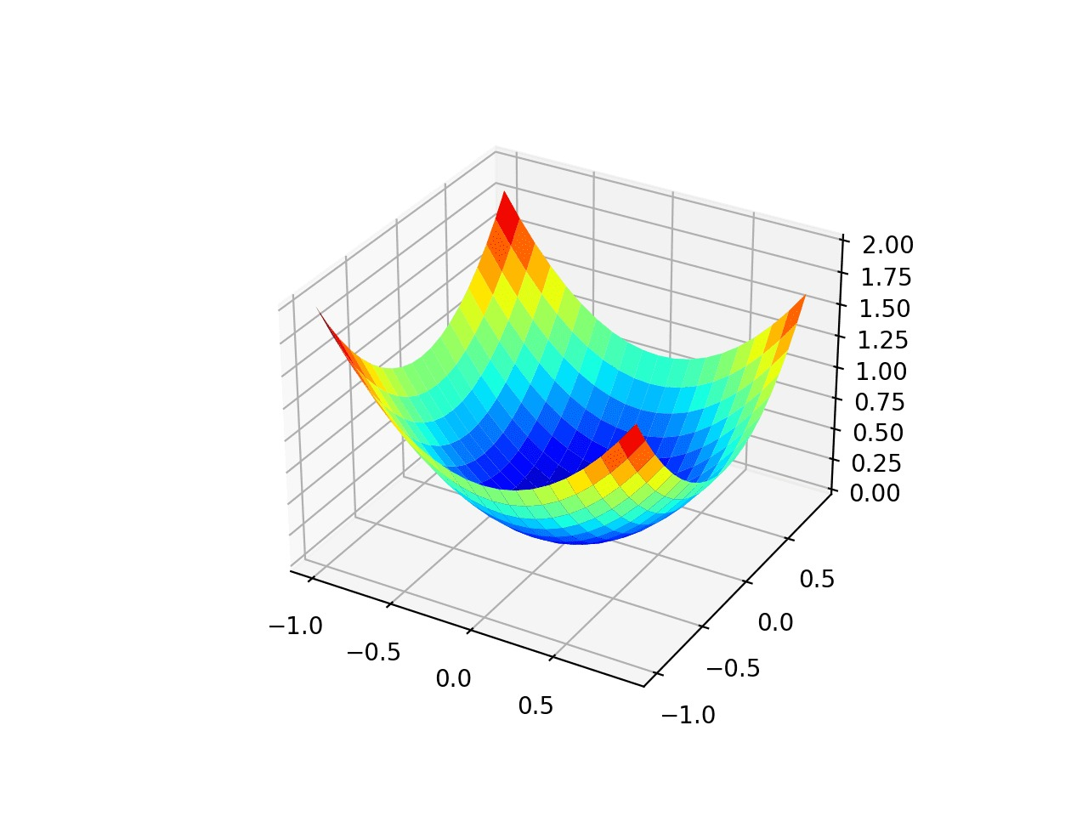
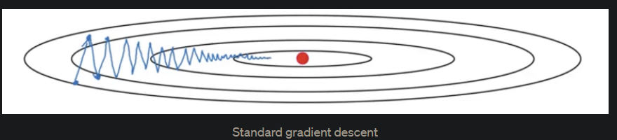
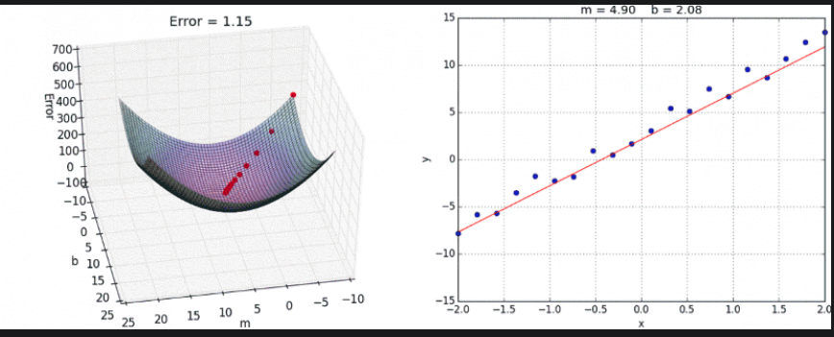
Optimizer

Slide 26

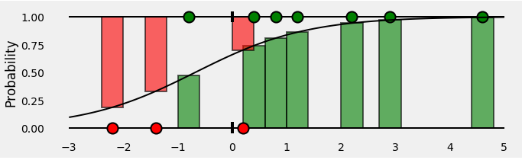
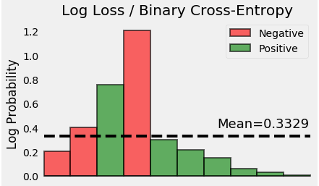
Binary cross-entropy
Binary cross entropy compares each of the predicted probabilities to actual class output which can be either 0 or 1. It then calculates the score that penalizes the probabilities based on the distance from the expected value. That means how close or far from the actual value.

Slide 27
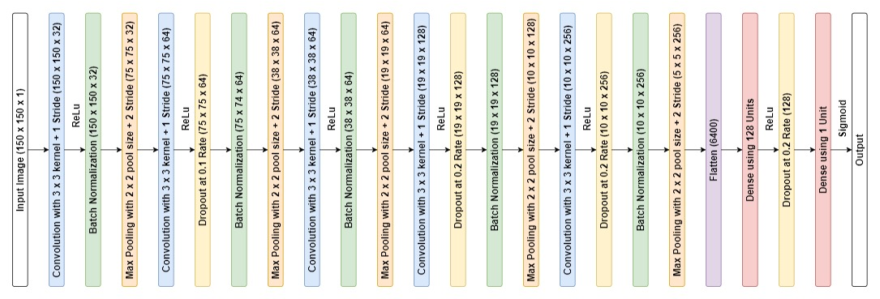
Summary of the convolution layer

Slide 28
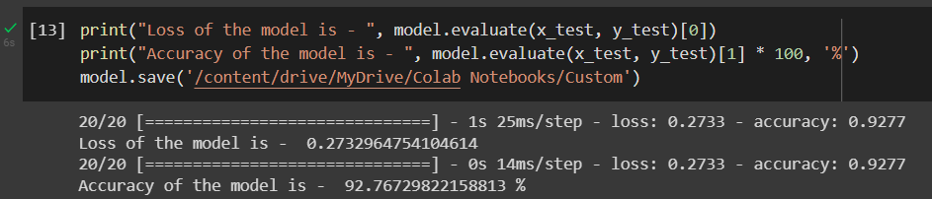
Testing Loss and accuracy

Slide 29
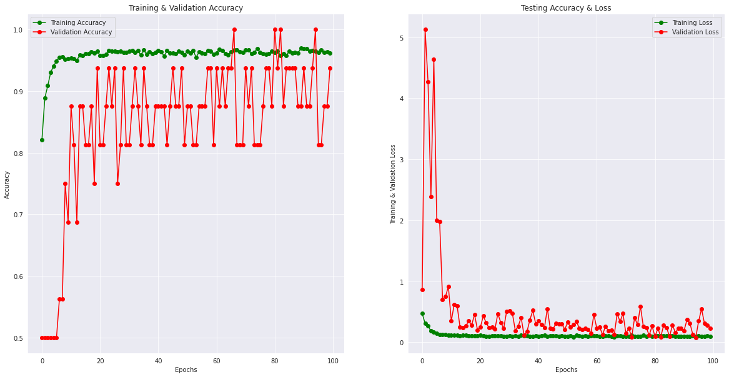
Training loss vs validation loss

Slide 30
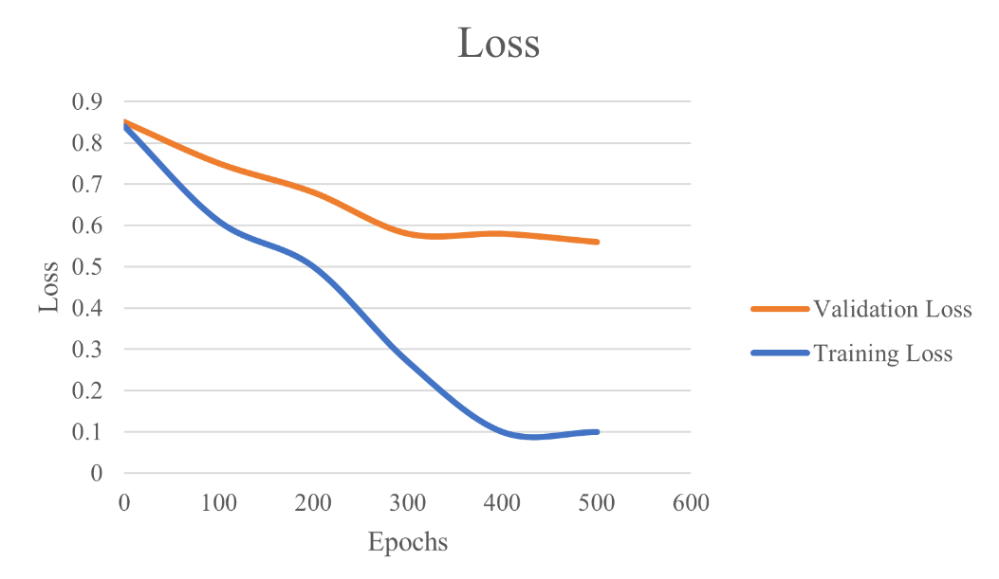
Training and Validation Loss
At times, the validation loss is greater than the training loss. This may indicate that the model is underfitting. Underfitting occurs when the model is unable to accurately model the training data, and hence generates large errors.

Slide 31

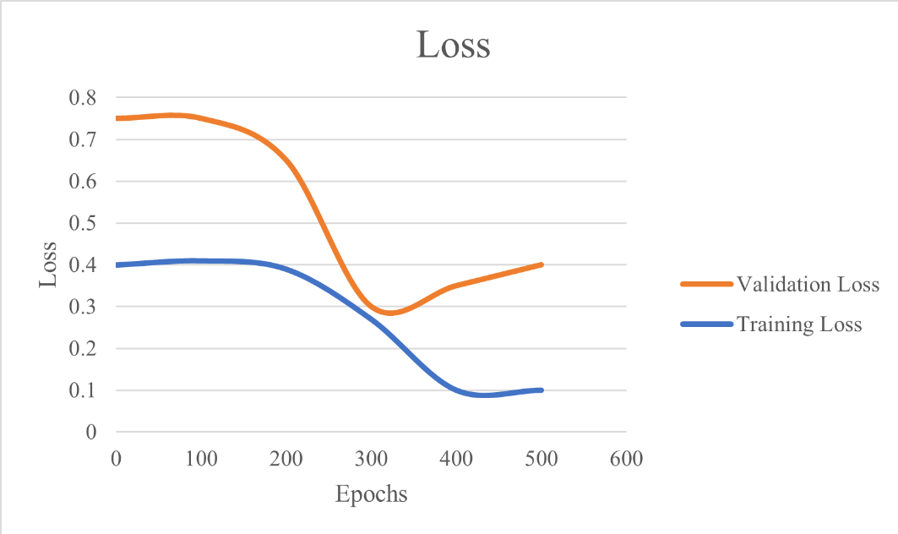
Training and Validation Loss
This usually indicates that the model is overfitting, and cannot generalize on new data. In particular, the model performs well on training data but poorly on the new data in the validation set. At a point, the validation loss decreases but starts to increase again.

Slide 32
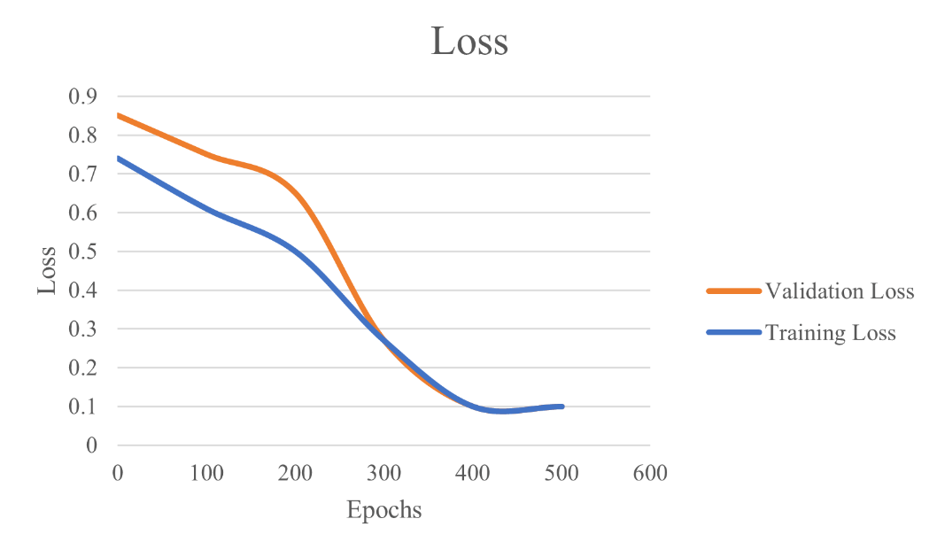
Training and Validation Loss
This indicates an optimal fit, i.e a model that does not overfit or underfit.

Slide 33
Predicting testing data using model
Predict is used to test the model on testing data. It predicts the label of a new set of data when given a trained model.
This function helps us to know how well the model has been trained by testing it with test and validation sets. Predict is can be used in test a image of X-ray and classify it as Pneumonia or Normal Sample.
We have Tested the Model by Using around 636 Images which are not used for training and 590 Images are predicted correctly

Slide 34
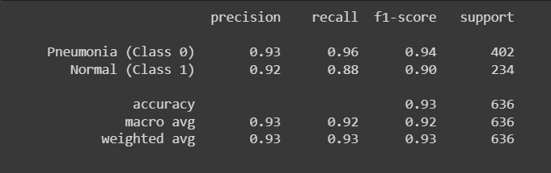
Classification report
A classification report consists of the following parameters:
Precision: precision is the number of true positive results divided by the number of all positive results, including those not identified correctly.
Precision = TP/(TP+FP)
Recall: Recall is the number of true positive results divided by the number of all samples that should have been identified as positive. Recall = TP/(TP+FN)
F1 score: It is the harmonic mean of precision and recall. The best possible score is 1 and the worst is 0. It is used to compare the performance of any 2 models.
f1 score=2*(Recall*Precision)/(Recall+Precision)
Support: Specifies the number of actual occurrences of class in the given dataset.

Slide 35
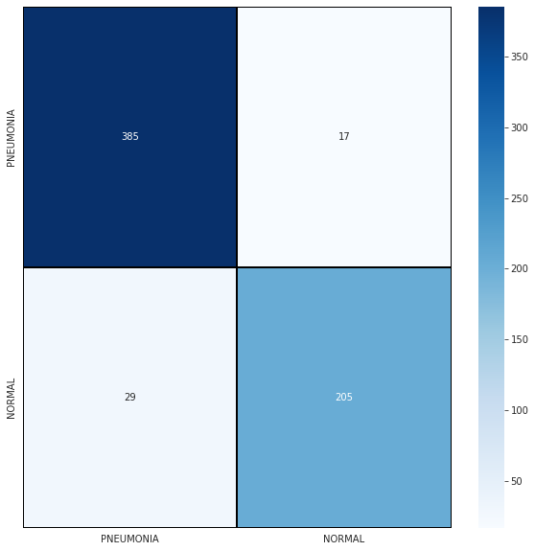

Confusion matrix
Confusion matrices are a widely used measurement when attempting to solve classification issues. Confusion matrices show counts between expected and observed values
The name stems from the fact that it makes it easy to see whether the system is confusing two classes (i.e. commonly mislabeling one as another).
TP- correctly identified positive cases
TN- correctly identified negative cases
FP- Falsely identified positive cases
FN- Falsely identified negative cases

Slide 36
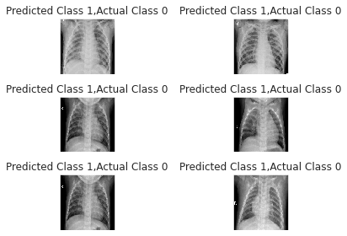
Cases where error has been made while predicting results

Slide 37
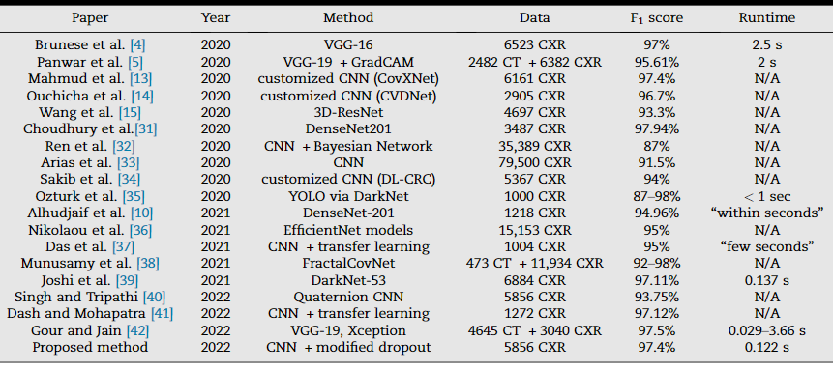
State-of-the-art methods

Slide 38
THE END

